Slide 1


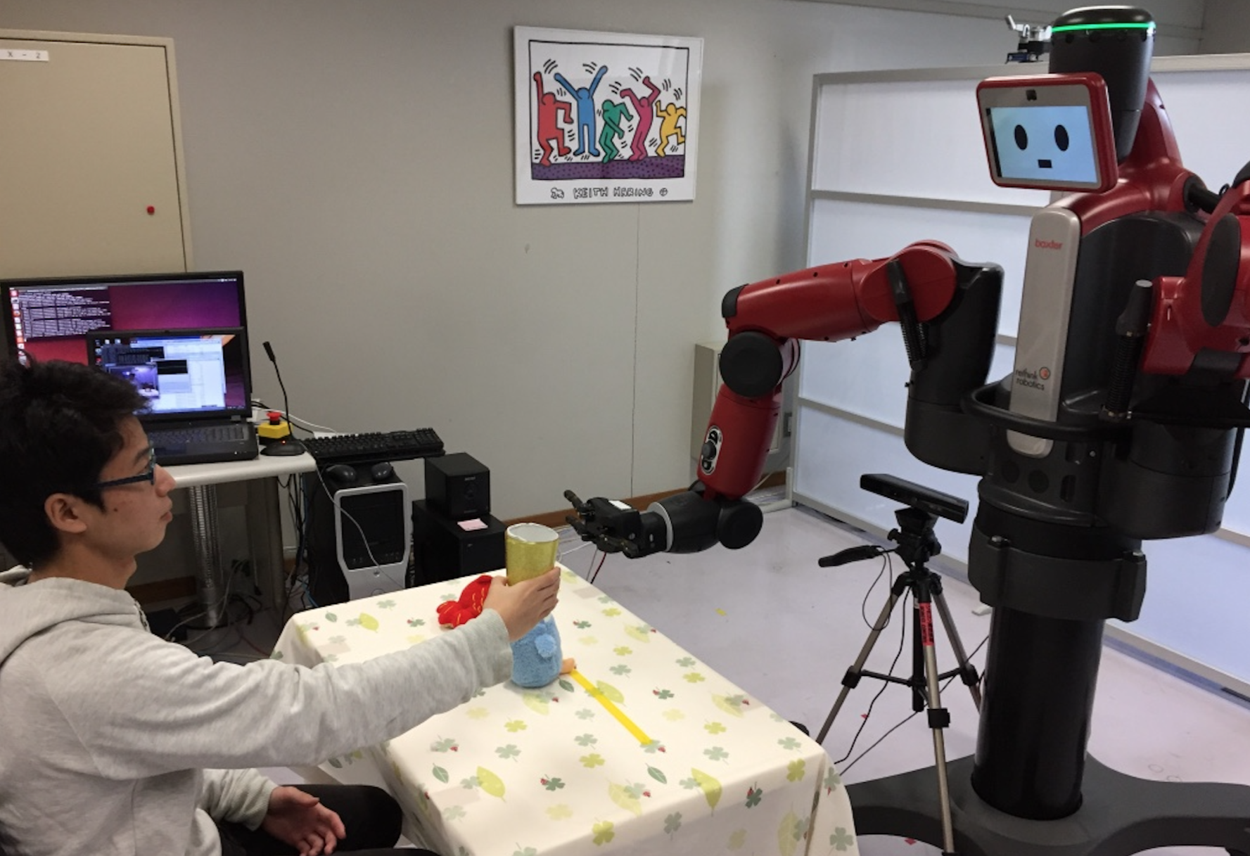
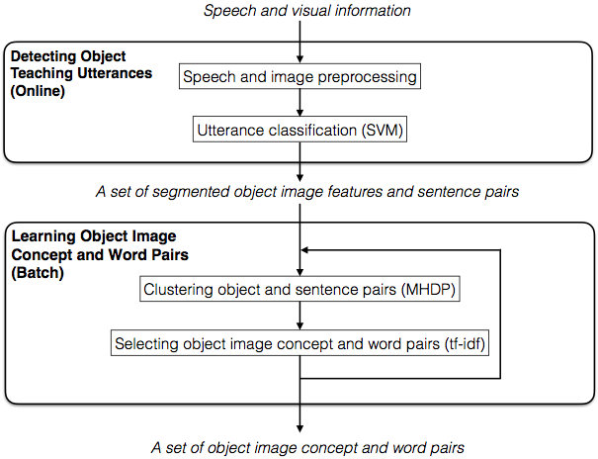
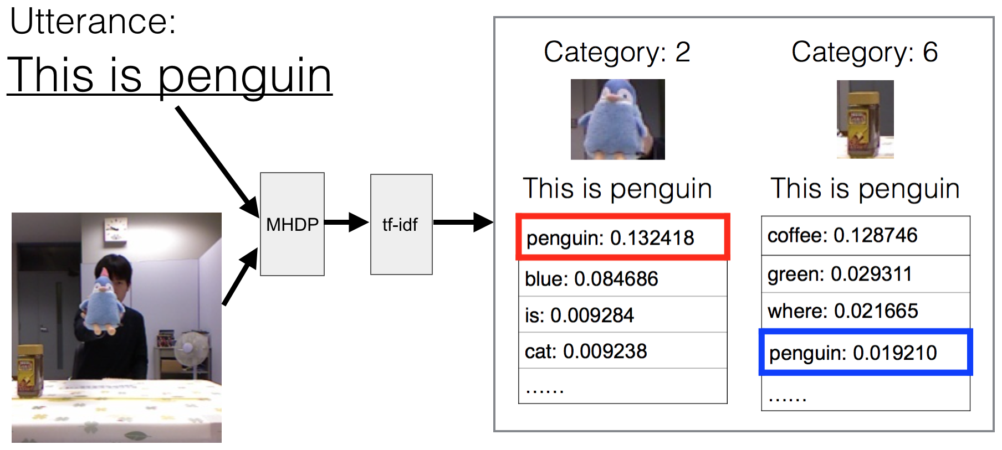
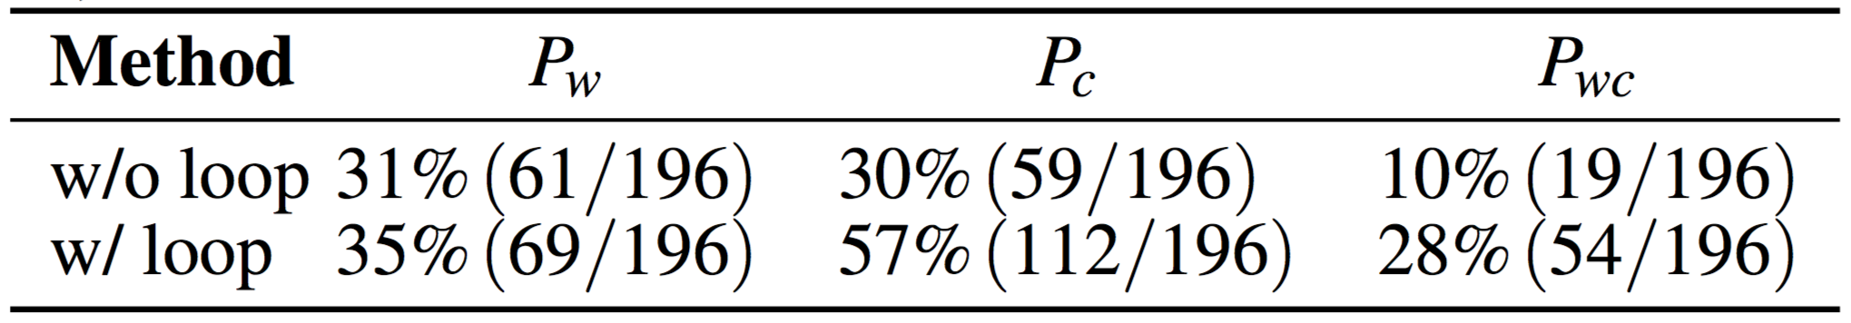
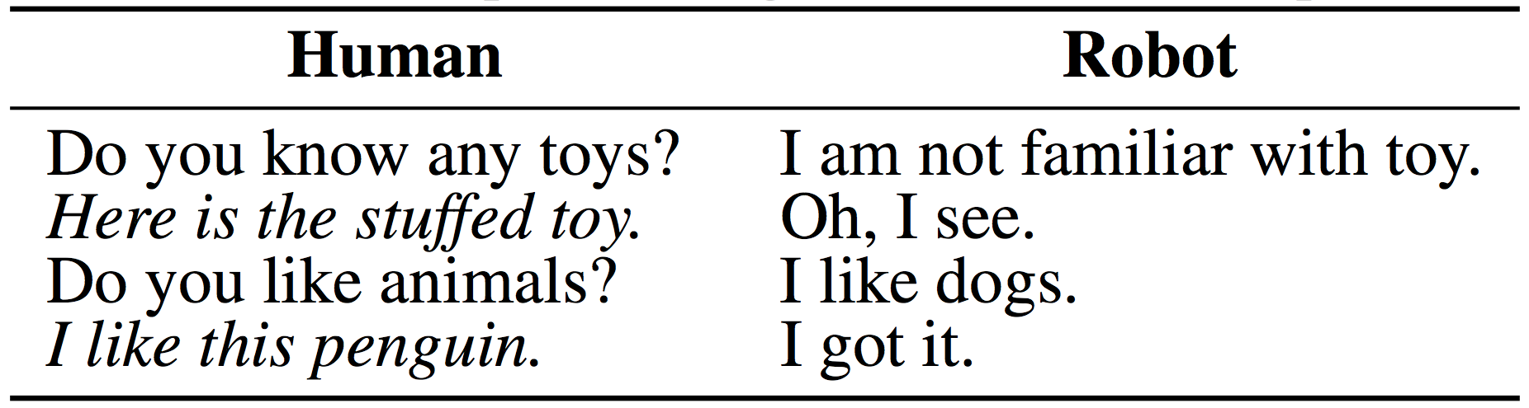



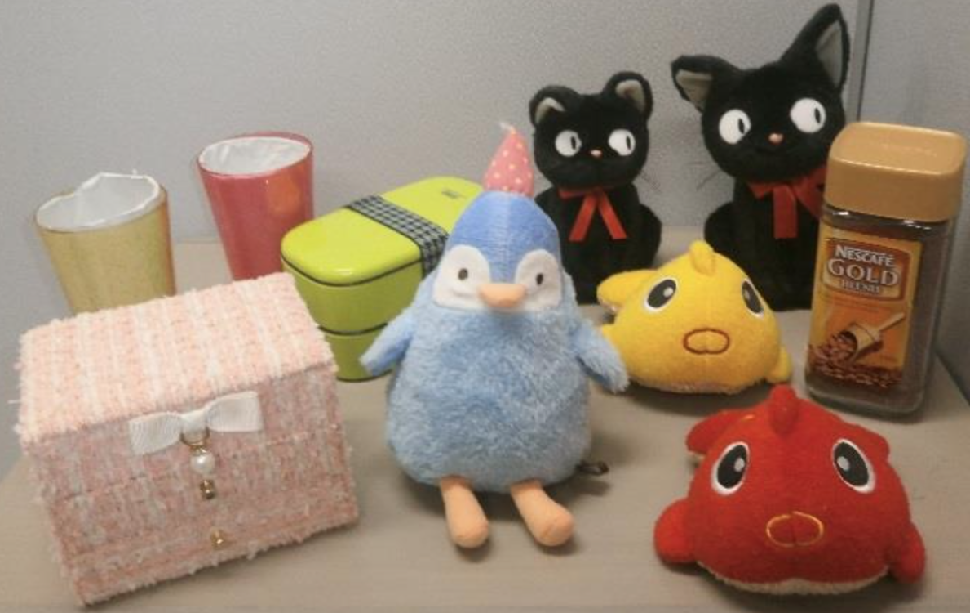
Symbol Grounding from Natural Conversation
for Human-Robot Communication
Ye Kyaw Thu^{λ}, Takuya Ishida^{λ}, Naoto Iwahashi^{λ},
Tomoaki Nakamura†, Takayuki Nagai†
λArtificial Intelligence Lab., Okayama Prefectural University (OPU), Okayama, Japan
†Intelligent Systems Lab., The University of Electro-Communications, Tokyo, Japan
1. Introduction
2. Experimental Environment
Symbol Grounding × Chatting
Research on language acquisition and symbol grounding (focus on the acquisition of physically grounded knowledge through utterances that express physical things, such as objects and motions)
Most of the previous studies have focused on learning without any prior symbolic knowledge
The problem of how to acquire physically grounded knowledge based on grounded utterances through natural interaction has yet to be explored
We focus on object-teaching utterances as grounded utterances
3. Propose Method
4. Learning Method (MHDP+tf-idf)
6. Results
Table. Results of learning accuracy of object and words (%)
5. Experimental Setup
some examples of dialogue conducted in the experiment are as follows:
Here,
: probability of selecting correct word in each sentence
: probability of selecting object image concept for each sentence
: probability of selecting both correct word and object image concept for each sentence
Result: without loop < with loop
The ten objects used in the experiment are as follows:
Here, two black stuffed toy cats (small & big), two stuffed toy fishes (red & yellow), and two cups (red & yellow)
ACKNOWLEDGEMENTS
This work was supported by JSPS KAKENHI (grant number 15K00244) and JST CREST (“Symbol Emergence in Robotics for Future Human-Machine Collaboration”)

